Slide 1
Dehazing and defogging using matlab
HEMANTH.Y-19BCE1047
VIJAY GOPU-19BPS1078
PRAVEEN G-19BCE1029

Slide 2
ABSTRACT :
Recently the most role and verywidly application fields have been seen in computer vision and graphics visualization, Computer vision applications are extinctly impaired when weather is unfavorable, which typically caused reducing visibility in capturing the clear images. In image processing techniques and contexts, hazing is a surrounding condition that effects scene objects clarity, attributed to the influence of moisturised in the atmosphere. Haze worsens clarity of scene objects, which consequently impacts the computer vision and also the graphic applications negatively. Here the role of the dehazing method still it is very vital in computer vision applications, it can make images more clear and oftenly used by taking off, haze from them, thus the scene vision will be incremented . From earlier up to now current scenerio, many methods have been proposed and methodology for improving images. The single image dehazing techniques and hazing images is one of them and recently the researchers are more interested and also widely used in this method. The primary contributions of this review study focus on explaining the cause of haze formation for images more clearly, general historical ,overview of single image ,dehazing methods, and also the hazing techniques explains the most equation used in the dehazing process those help to contributing the newly used methods to remove hazing and clarify the hazy image, and clarify the pros and cons of haze removal methods.

Slide 3
INTRODUCTION:
Haze in atmosphere is an observable fact that obscures the cleanliness of the sky. Most of the impurities in air ranges below 1000m. Atmospheric impurities are mist, fog, and smog and some amount of dust. Haziness is caused due to impurities in air due to the secondary conditions. This occurs in many populated areas like industrial areas and also big metropolitian cities. Due to the haze clarity of images will be degraded. Haziness consists of "Airlight" and "Direct attenuation" That is Haze = Attenuation + Airlight . Increasing in the consumption due to industrial production and human activities , the concentration of atmospheric particulate matter (PM) present in the atmosphere had considerably increased, leading to the frequently occurrence of fog and haze in the atmosphere.

Slide 4
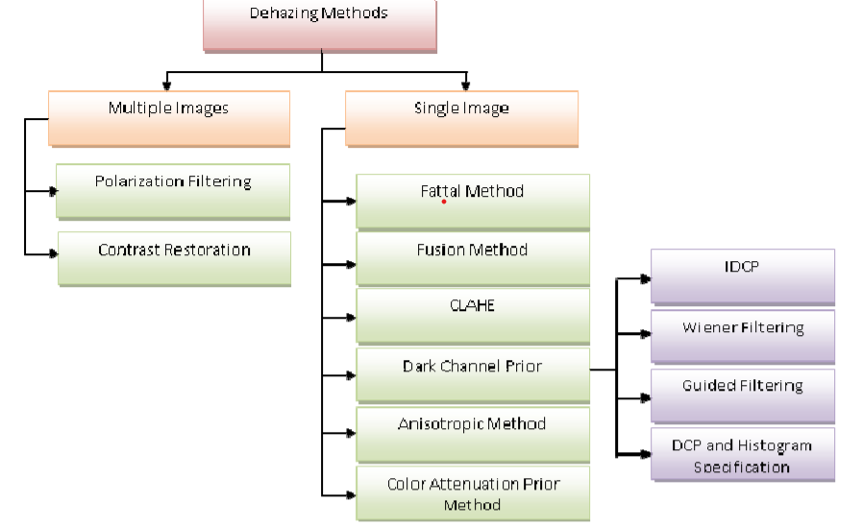

Slide 5
PROPOSED METHODOLOGY:
Guided Filtering: using another DCP variant with guided image filtering particularly for applications when the large grey area was similar to the global air light. The output haze free image was also good at edge preservation
Dark Channel Prior(DCP) : proposed a dark channel prior based methodology and was one of the most widely technique till now. The authors assumed that most local patches in non-sky region had low intensity in one of the color channel and then thickness of haze was accessed from it and finally it was used to restore the output image. The low intensity was usually due to colorful objects and surfaces. Many variants of the said technique had been widely used till now. Some of the variant techniques of the DCP technique are used.

Slide 6
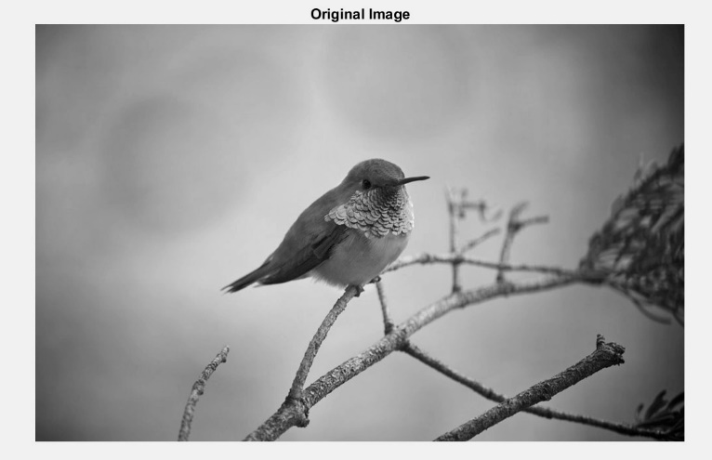
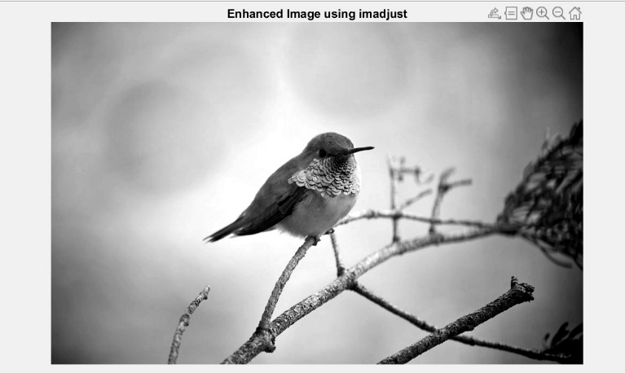
RESULTS:
The given image in bird is not so clear it looked smooth and edges are very thin so we applied some enhanced images to make it more visible and to make the edges more sharp and smoothened

Slide 7
The above given image is filled with fog to make it clear for visible road we applied hazing techniques to remove all the fog and noise it makes road clear and visible
Original image
Enhanced image
Enhancement(advance)

Slide 8
CONCLUSION:
The role of dehazing methods in the present situation is very bright in recent years because one of the most important fields appears to be more valuable for many vision applications, so there are many applications available concerning and overcoming the field of computer vision and graphics depend on these methods. It can dislocation haze from the pictures, increment the scene vision. Several dehazing techniques have been used from beginning up to now to remove the haze and improve images, and recently become most filed the researchers concerned. So, the dehazing technique has a major role to solve these kinds of problems. This survey contributes to explain the cause of haze formation, the summary introduction to image enhancement and restoration algorithms and their associated methods, and learning about hazy image’s characteristics and many problems whereas catching an image. But each and every algorithm has certain details and characteristics that distinguish it from other algorithms

Slide 9
REFERENCES:
[1] Y. Song, J. Li, X. Wang, and X. Chen, “Single Image Dehazing Using Ranking Convolutional Neural Network,” IEEE Transactions on Multimedia, 20.
[2] Z. Rong and W. L. Jun, “Improved wavelet transform algorithm for single image dehazing,” Optik-International Journal for Light and Electron Optics, vol. 125, no. 13, pp. 3064–3066, 2014..
[3] K. He, J. Sun, and X. Tang, “X.: Single image haze removal using dark channel prior,” 2009.
[4] A. K. Tripathi and S. Mukhopadhyay, “Single image fog removal using anisotropic diffusion”, IET Image Process, vol. 6, no. 7, pp. 966–975, 2012.
[5] W. Wang and X. Yuan, “Recent advances in image dehazing,” 2017.
[6] www.mathworks.in.

Slide 10
Thank you

